Slide 1
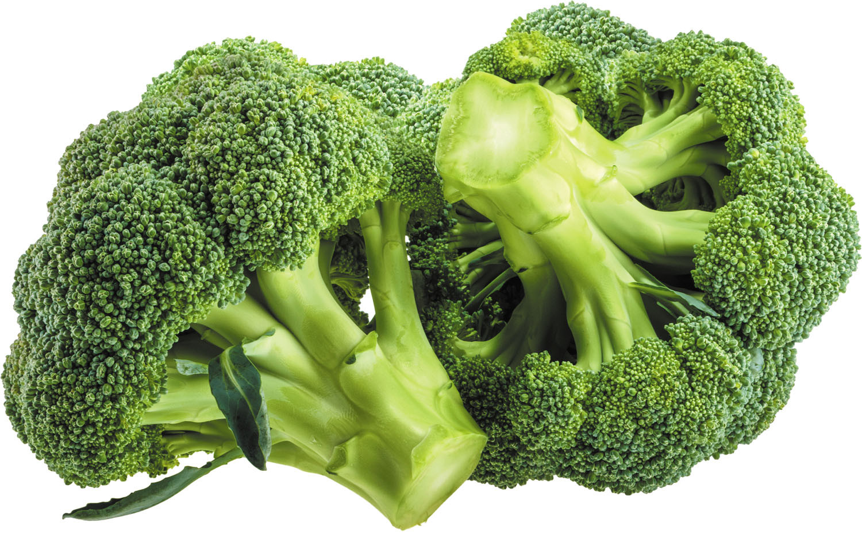
Did you Know?
Green vegetables no longer have the same nutritional value as they did 20 years ago?

Slide 2
ISSUES FARMERS ARE FACING
Across Botswana, farmers are facing serious challenges:
Struggling to make ends meet
Declining yields
Climate unpredictability
Low commodity prices, making it difficult to compete.
Soil degradation

Slide 3
CAUSEs OF soil degradation
One major problem is how we farm.
Growing the same crop repeatedly .
“Monocropping” removes the same nutrients from the soil.
The heavy use of chemical fertilizers, fungicides, and insecticides damages soil life.
Over time, the soil becomes weak and so do the crops

Slide 4
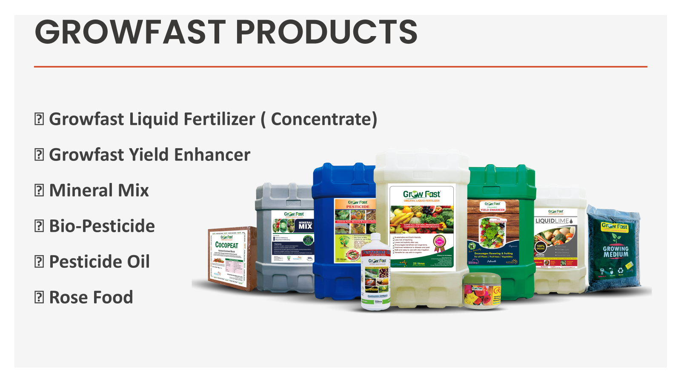

Slide 5
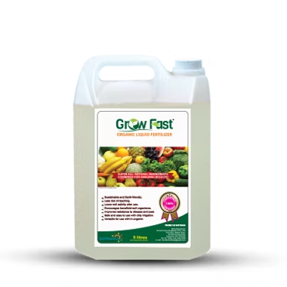
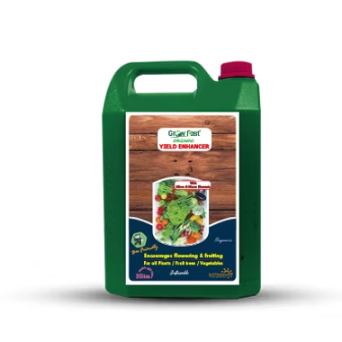
GrowFast Products
GrowFast Liquid Fertilizer
Biostimulant
Improves soil condition
Contains Nitrogen fixing bacteria (Azotobacter)
PSB : Phosphate-solubilizing bacteria (bacillus)
Pseudomonas (disease control +growth)
GrowFast Yield Enhancer
Contains Macro and micro elements
Promotes fruiting and flowering
Enhances size, taste and flavor of fruits and vegetables

Slide 6

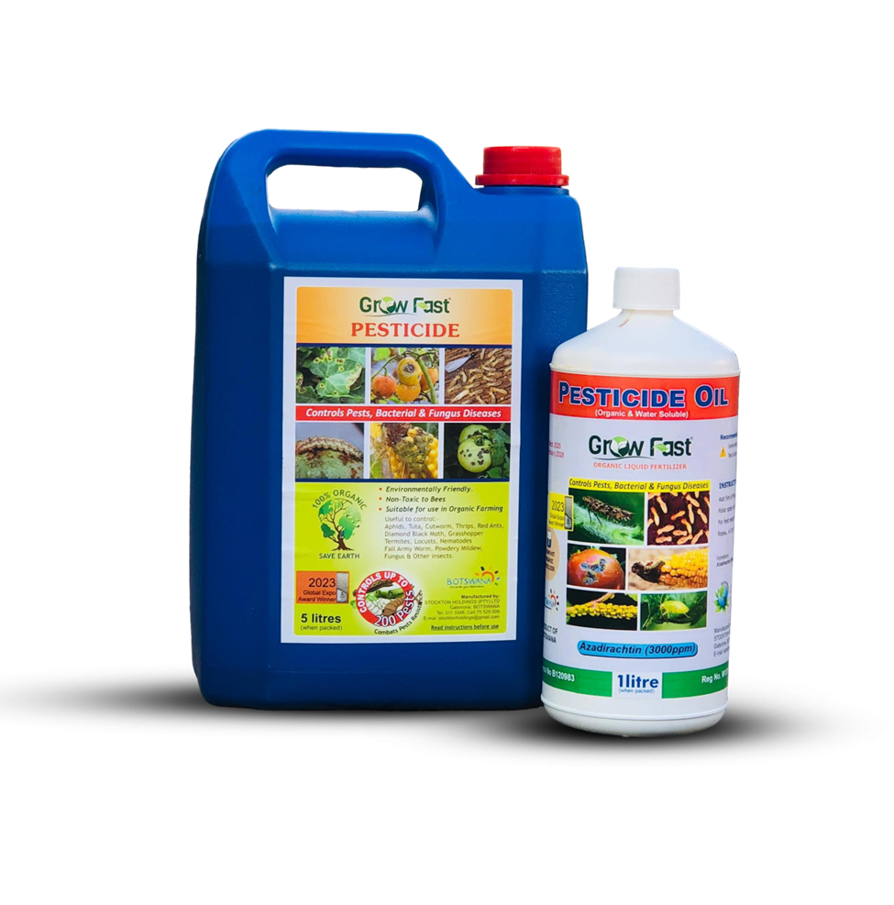

INTEGRATED Pest Management
Bio Pesticide
Contain natural microorganisms or plant extracts that kill various pests and diseases.
100% biodegradable
Bee friendly
Zero withdrawal period
Pesticide oil
Neem based formulation that prevent and control soft bodied sucking and chewing pests.
Tip: Combine them both together to break pest resistance!

Slide 7
Importance of Growfast Products
100% organic
No harmful residues
Improves long-term productivity
Contains various enzymes and organic acids which improve soil fertility.

Slide 8
REGENERATIVE FARMING
Regenerative farming is an approach in agriculture that focuses on restoring and improving the soil health while still producing crops and making profit.
It includes:
Growing multiple crops
Practicing crop rotation
Reducing chemical use
The goal is to bring life back into the soil.

Slide 9
ROLE OF LABILE CARBON
A key concept in regenerative farming is labile carbon.
Labile carbon is the active easily available form of carbon in the soil—it feeds microorganisms within the soil.
These microorganisms:
Boosts microbial activity
Break down nutrients and make them available to the soil.
Improves soil structure and water retention
When soil life is active, plant growth improves naturally.

Slide 10
How to increase labile carbon in soil
Apply compost, crop residues, manure.
These are direct sources of carbon.
Use organic fertilizers
Organic inputs like GrowFast Fertilizers stimulate microbial activity.
Crop Rotation
Different crops release different root exudates.
Cover cropping –
Keeps soil covers and adds continuous organic material.

Slide 11
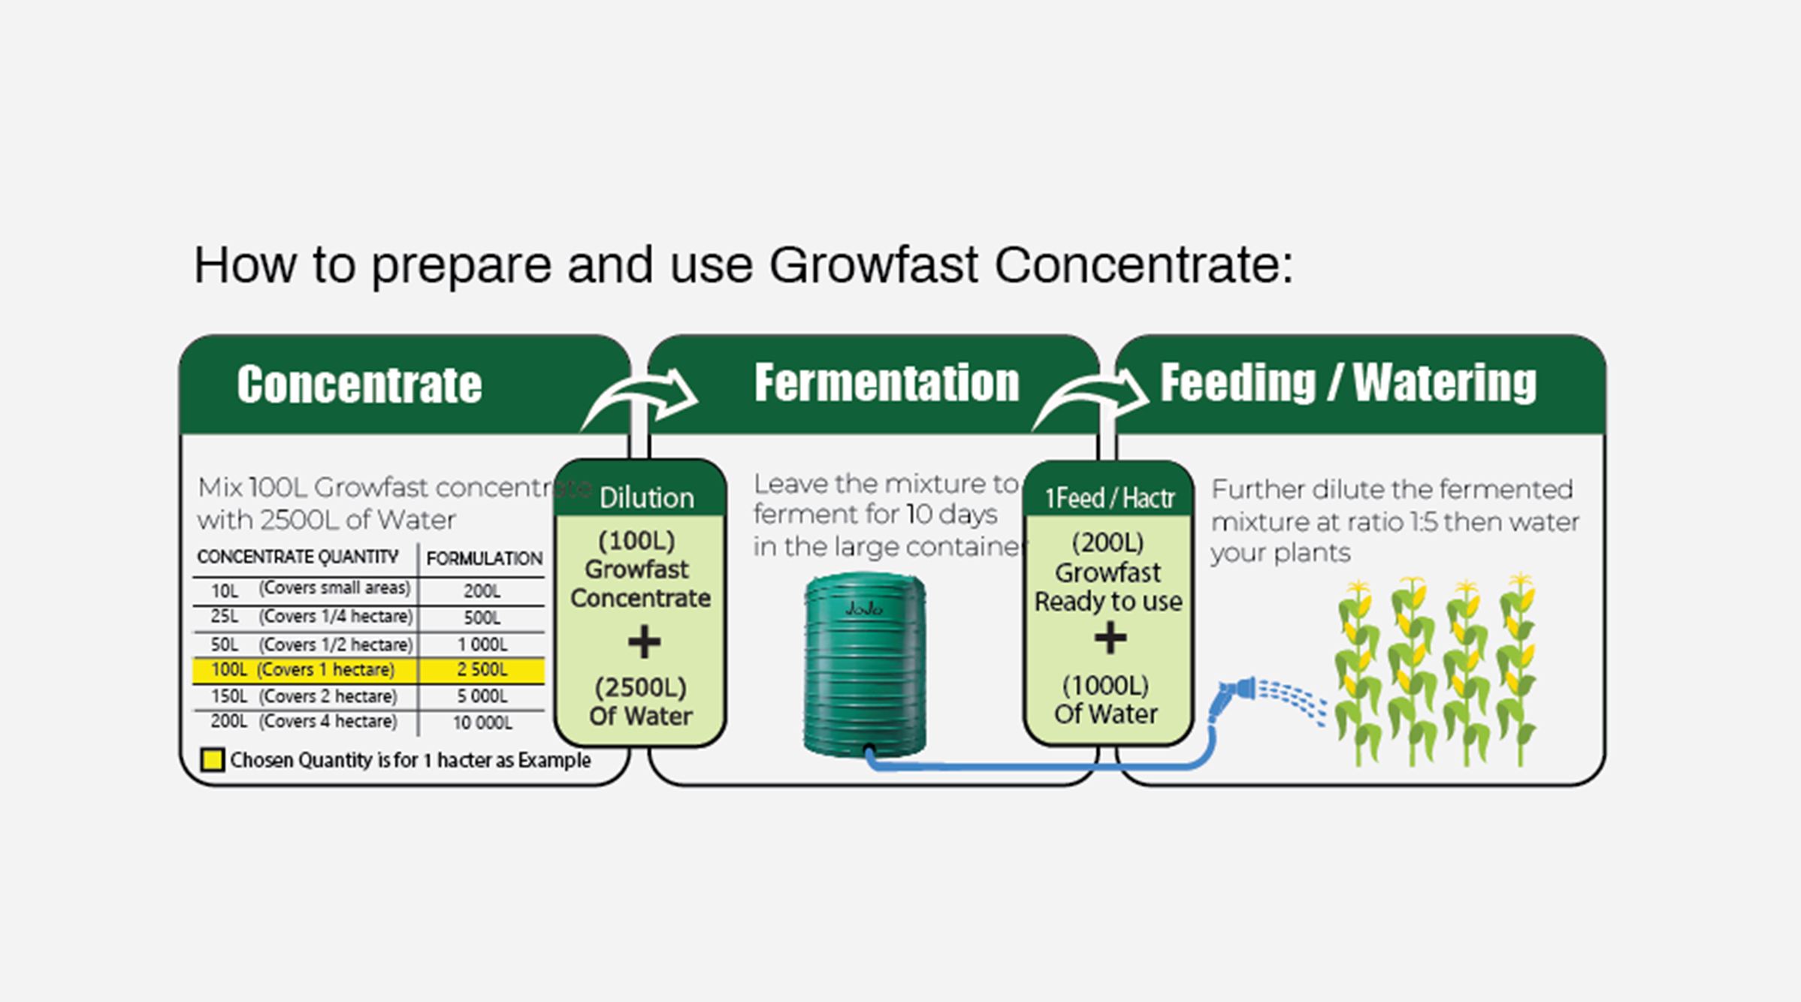
GrowFast Concentrate Picture

Slide 12
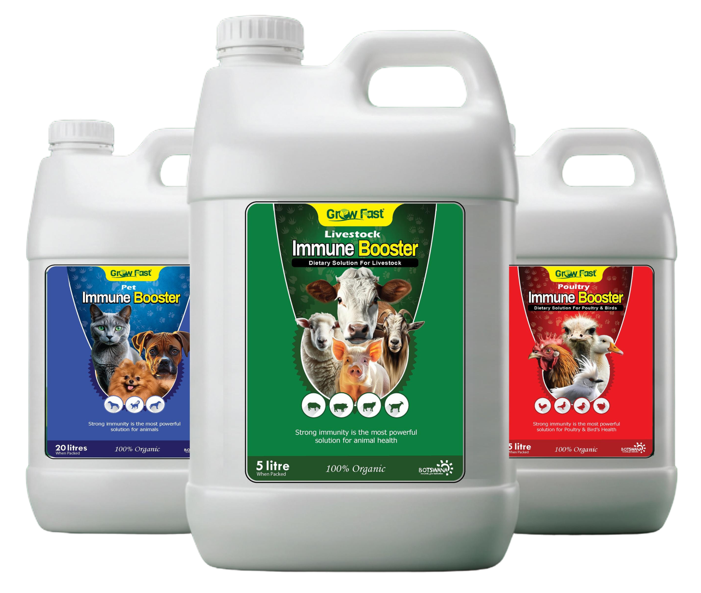
OUR OTHER PRODUCTS
AMIMAL IMMUNE BOOSTERS
Livestock Immune Booster
Poultry Immune Booster
Pet Immune Booster
100% Organic

