Slide 1
Department of Plant Health
Presentation shared at
Gola Venture Botswana Workshop
EDWIN L. MONAMODI
Venue:BUAN CONFERENCE FACILITY
April 16, 2026

Slide 2
PRESENTATION OUTLINE
HISTORY(1986/87)
DIVISION OF PLANT PROTECTION
FORMATION OF PLANT HEALTH DEPARTMENT.
MANDATE OF PLANT HEALTH DEPARTMENT.
FUNCTIONS

Slide 3
DIVISION OF PLANT PROTECTION
1986-87 Division of Plant protection formed.
1986- Outbreak of Brown Locust from Karoo Region in South Africa.

Slide 4
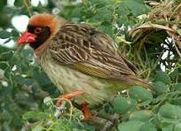
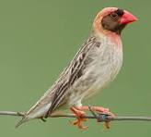
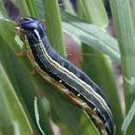
MANDATE( PLANT PROTECTION)
Control of Migrant Pests( Quelea, Locusts. African Armyworm)

Slide 5
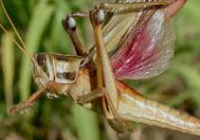
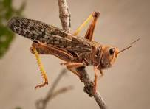
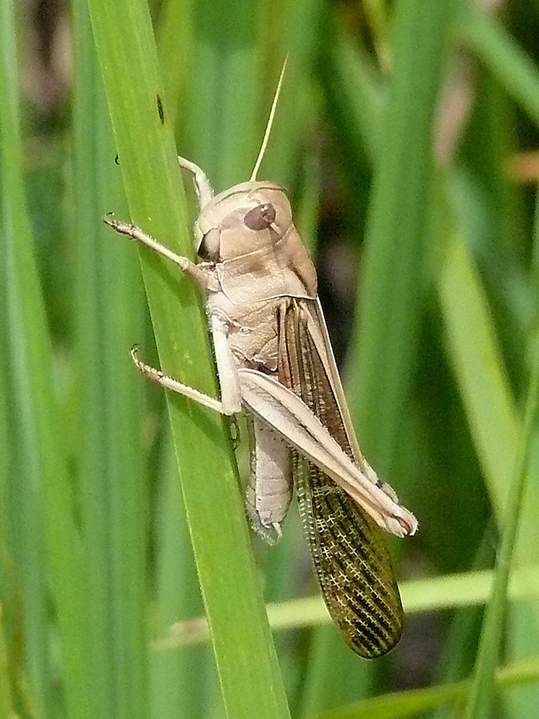
LOCUSTS

Slide 6
Other pests
Rodents( Rats) – Recent out break
Corn Cricket.- Airport
To provide technical advice on management of non- migrant pests, weeds and Diseases - CBS.
Conduct Demonstrations – Weeds control.
Weeds / Eggs contamination of product – MKT rejection

Slide 7
Statutes
Pests and Diseases Act of 1958.( Plant Protection Act 2007 ACT)
Locust Act.
Noxious Weeds Act cap 35:04.
Agrochemicals Act 1999.

Slide 8
SECTIONS AND UNITS UNDER PLANT PROTECTION
Pest management - Migrant, non migrant, Weeds
Disease Management - Laboratory
Post harvest
Pesticide management( Office of the Registrar)
2007- Phytosanitary from DAR – Plant Protection – MKT ACCESS. Movements of plants and plants products

Slide 9
FORMATION OF PLANT HEALTH DEPARTMENT
2023 Formation of DPH from Plant protection.
Inherited the Division of Plant Protection and the Registrar.
Sections
Phytosanitary.- Import and Export of Plant and plant products
Post Harvest.- Handlings, Storages health, Purity
Pest management.- Inspectors
Pesticide management. - Inspectors

Slide 10
MANDATE OF DPH
Established by Plant Protection Act cap 35;02. An Act to prevent the introduction, spread and establishment of plant pests, to facilitate trade in plants, to enable Botswana to comply with its international obligations.
Control movement of Plant and Plant products,
Market access
Guided by International Phytosanitary Standards(ISPMs)
Monitoring and control of Migrant pests( pests of economic importance)

Slide 11
MANDATE
Provide technical advice on management of other pests, diseases and weeds.
Regulate Agrochemicals( Agrochemicals Act cap 35:09) An Act to provide for Licensing and registration of Agrochemicals, to control or regulate their importation, manufacture, distribution, use and disposal, so as to prevent pollution to the environment or harm to human. Plant or animal life.

Slide 12
Issuance of plant, plant products import permit/phytosanitary certificate
Department of Plant Health is mandated to :
regulate and restrict movement of agricultural commodities for the purpose of exclusion, preventing the establishment of plants, pests and diseases in the area where they are not present”, hence all commodities (plant and plant products) entering and exiting this country has to undergo thorough inspection to ascetain compliance.
This service allows/enables Importers and Exporters to import/export plant and plant products.

Slide 13
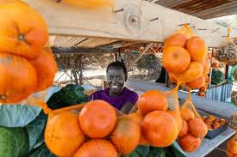

Who is eligible?
Individuals (citizens and non-citizens)
Registered company with Registrar of Companies for a Trading License
Registered businesses (Hawkers/Vendors)

Slide 14

How do I get this service?
Interested citizens and businesses are required to visit the nearest District Crop Production Office with relevant supporting documents.
Complete an application form to import the plant and plant products.
Forms can be completed and send via email to MoAPlantPermits@gov.bw.

Slide 15
cont.......
Importing and exporting plants or plant products in Botswana requires a Plant Import Permit (P200.00) or Phytosanitary Certificate (P450.00) issued by the Department of Plant Health to ensure compliance with biosecurity regulations.
The documents (permit and phyto) are administered through Plant Protection Act CAP35:02.

Slide 16
cont......
Pay the prescribed fee physically or at the District Crop Production Office or electronically at the following banking details:
Bank name: | Bank of Botswana
Branch: | Gaborone
Swift code: | B BOT BW GX
Account name: | Government of Botswana Remittance Account
Account number: | 010 100 001 662 0000/100 001 662 0000
Reference: | 0512-23429-Phytosanitory permits 0512-23285- Agrochemicals

Slide 17
Note
If paying electronically proof of payment is required before a permit or Phytosanitary certificate is issued.

Slide 18

Import Procedure
For IMPORT of plant or plant product, provide the following details:
*Name and address of importer (Physical or postal)
*Name and address of exporter (Physical or postal
*Quantities and type of plants or plant products to be imported
*Port of entry
*Mode of transport
Note:The plant or plant products to be imported shall be inspected to ensure that they meet the import conditions.

Slide 19
What supporting documents are required?
For IMPORT of plant or plant product the following are required:
Proof of payment
Completed Application form
Company documents( Certificate of incorporation+extract)
Authorisation letter

Slide 20

Plant And Plant Products On Transit
When goods are on transit, the client should produce the following for Plant Health to issue transit permit:
permit from importing country
Phytosanitary certificate from exporting country if required by the importing country
Proof of payment
Completed Application form
Company documents
Authorisation letter

Slide 21
Requirements For Agrochemicals Trading
The person dealing with agrochemicals should have gone through agrochemicals training
pay a fee of P300.00 to apply for a license (import,selling,manufacture,transit)
acquire an agrochemicals license to deal with these products
allowed to import only registered agrochemicals

Slide 22

Importation of agrochemicals with Temporary Import Permit
pay P130 for this permit
apply and request for permission from Minister and can bring in products on approval for own use not sale
these products should be registered at country of origin
the permit is single entry

Slide 23

For EXPORT of plant or plant product
Provide import permit from importing country
Apply for phytosanitary certificate
The plant or plant products to be exported shall be inspected to ensure that they meet the import conditions of the importing country
Proof of payment
Completed Application form
Company documents
Authorisation letter

Slide 24

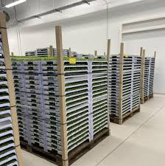
Exporting Plants And Plant Products
NOTE:
Notify Department of Plant Health of your intention to export on the onset of planting for active growth inspections
Please note that there might be some laboratory testing required (+/- 2 weeks).

Slide 25
FINALLY
When planning to import or export plants,plant products and agrochemicals,ensure that you enquire about all the processes to avoid non -compliance and confiscation of your goods as well as penalties associated with that.

Slide 26
NARROWING TO MARKET ACCESS ISSUES FOR FURTHER CLARITY

Slide 27
MARKET ACCESS FOR PLANT AND PLANT PRODUCTS

Slide 28
OUTLINE
What is market access
Why do countries need to seek access to market
Importance of market access
Types of market access
Update on available markets

Slide 29
WHAT IS MARKET ACCESS
Market Access for plants and plant products involves the ability for exporting countries to sell their products to importing countries.
The process involve a relatively straight and forward process, while in other circumstances the process can be very complex.
The complexity of the process will reflect the nature and level of the phytosanitary risk the importing country might be exposed to and
Whether regulatory measures are available to address the risk

Slide 30
Why do countries need to seek access to market
This process is crucial for ensuring that products meet the necessary standards and regulations of the importing country.
The process is influenced by various factors including:
Phytosanitary measures
International agreements

Slide 31
TYPES OF MARKETS
We have two types of markets which are:
Permit market (Relatively straight forward process) and
Protocol market (Complex process)

Slide 32
Permit market
This market simply request an import permit from one country to another.
Once the import permit is issued it automatically indicate that a market has been granted.
A Permit market system has specific requirements and conditions set by the importing country.
The process involved in permit market is very short
The exporting country only need to comply with the set conditions of the importing country

Slide 33
Protocol market?
The initiation of the process, takes the form of a written submission from the relevant government authority of the exporting country to the counterpart agency of the importing country.
The protocol market involves a structured process that includes:
negotiations between countries
preparing technical market access submissions
undertaking pest risk analysis before developing import conditions
NB: Protocol market process can be complex and may take years to complete, depending on:
The nature of the product
The ability to satisfy the techno-regulatory requirements of the importing country.

Slide 34
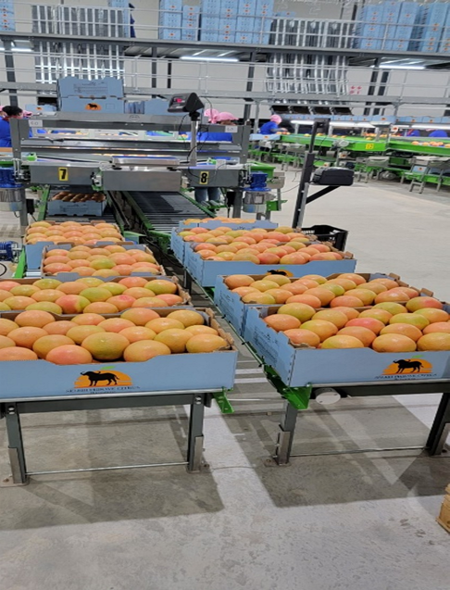
Update on available markets
Currently the department - BW has acquired market access for fresh citrus fruits to
EU, Canada, Singapore, United Kingdom, United Arab Emirates, Hong Kong, Oman, Zambia, Saudi Arabia, Iraq, South Africa, Bangladesh, Taiwan, Malaysia, Namibia, Russia, Zimbabwe, Indonesia , Mozambique and Phillippines
Negotiations for other markets for citrus fruits in order to expand the market is still on-going between Botswana and the following countries and the negotiations are at different stages:
America
Korea
China and
India

Slide 35
Update on market access continues……..
The department has also been granted market for farmers for the following commodities:
Safflower grain to USA (Does not require phytosanitary certificate)
Dried moringa and turmeric to EU (Does not require phytosanitary certificate)

Slide 36


THANK YOU

