Slide 1




SPECIAL ECONOMIC ZONES
Export Opportunities for Commodity Cluster Products
Geraldine Sebusang
Manager- Investor Licensing
Email: sebusang@seza.co.bw
17 April 2026

Slide 2
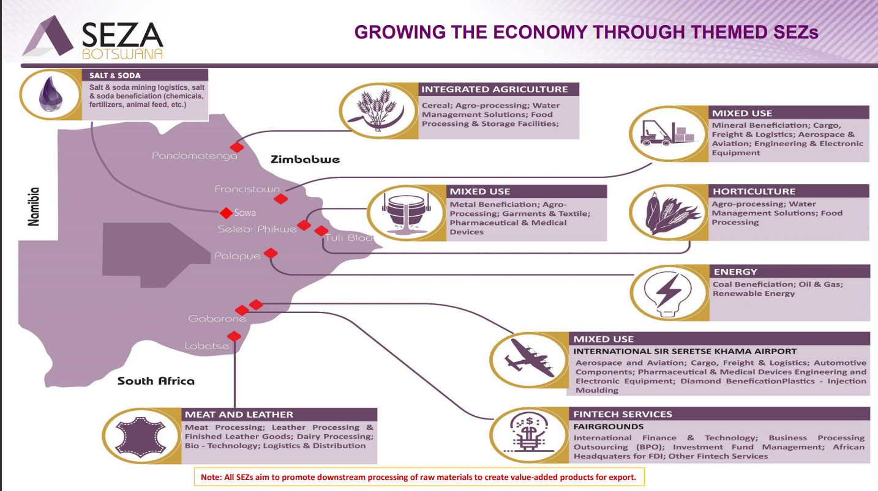

Slide 3
SPECIAL ECONOMIC ZONES
      Who we are
Objectives of the Authority:
Overall coordination and implementation of activities related to the establishment and development of Special Economic Zones
Facilitate investors setting up within the SEZs
Regulation of all entities and activities
Link SEZ investors to clusters
Industrialisation
Export diversification

Slide 4
Special Legislative and Regulatory Framework
…cont’d
SEZ Regulated Areas of Investment
____________________________________________________
Manufacturing
Internationally traded services
Warehousing, distribution & logistics
Targeted businesses or services
Agrobusiness
Agrobusiness
Note:
All SEZs aim to promote downstream processing of raw materials to create value-added products for the export markets.

Slide 5
Special Legislative and Regulatory Framework
…cont’d
Profile of a SEZ Investor
____________________________________________________
Backward & Forward linkages
Export oriented
Value addition
Note:
All SEZs aim to promote downstream processing of raw materials to create value-added products for the export markets.

Slide 6
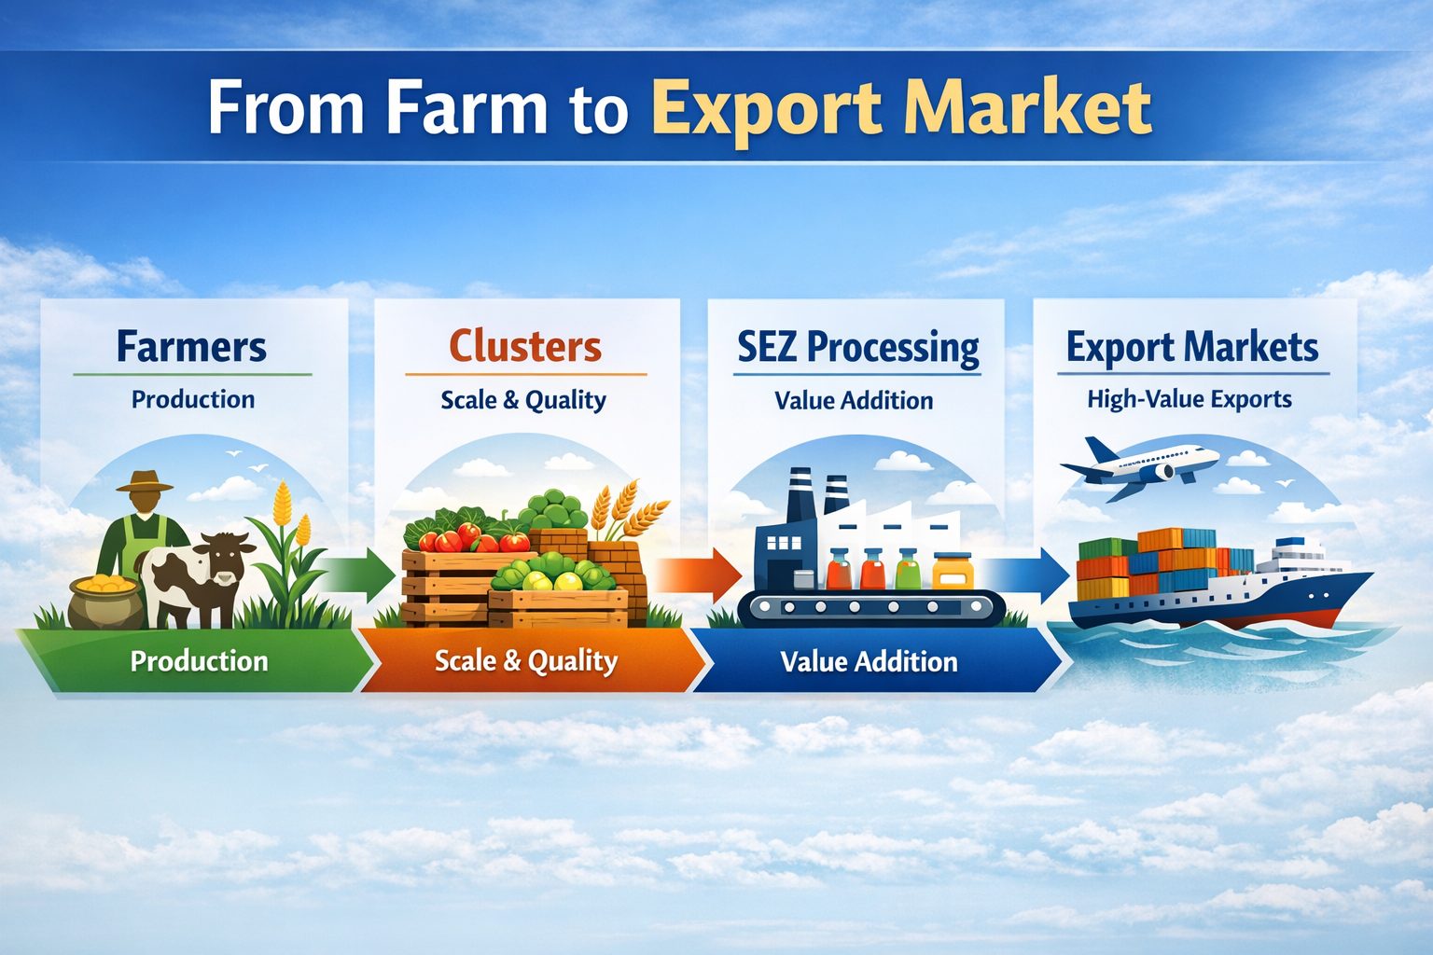
Special Legislative and Regulatory Framework
…cont’d
Clusters & SEZs Linkage
____________________________________________________
Notes:
Clusters supply inputs
SEZs process
Exports globally

Slide 7
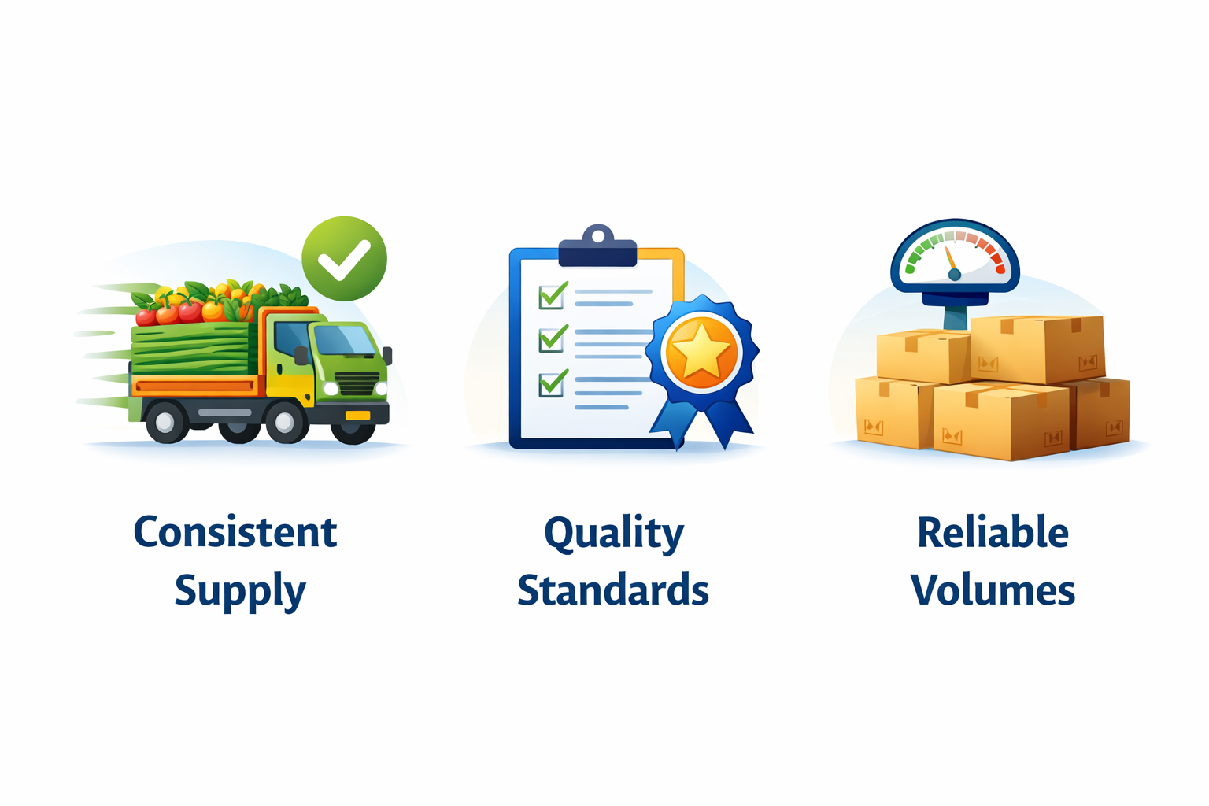
Success of Cluster & SEZ Partnership
____________________________________________________
Notes:
Clusters supply inputs
SEZs process
Exports globally

Slide 8
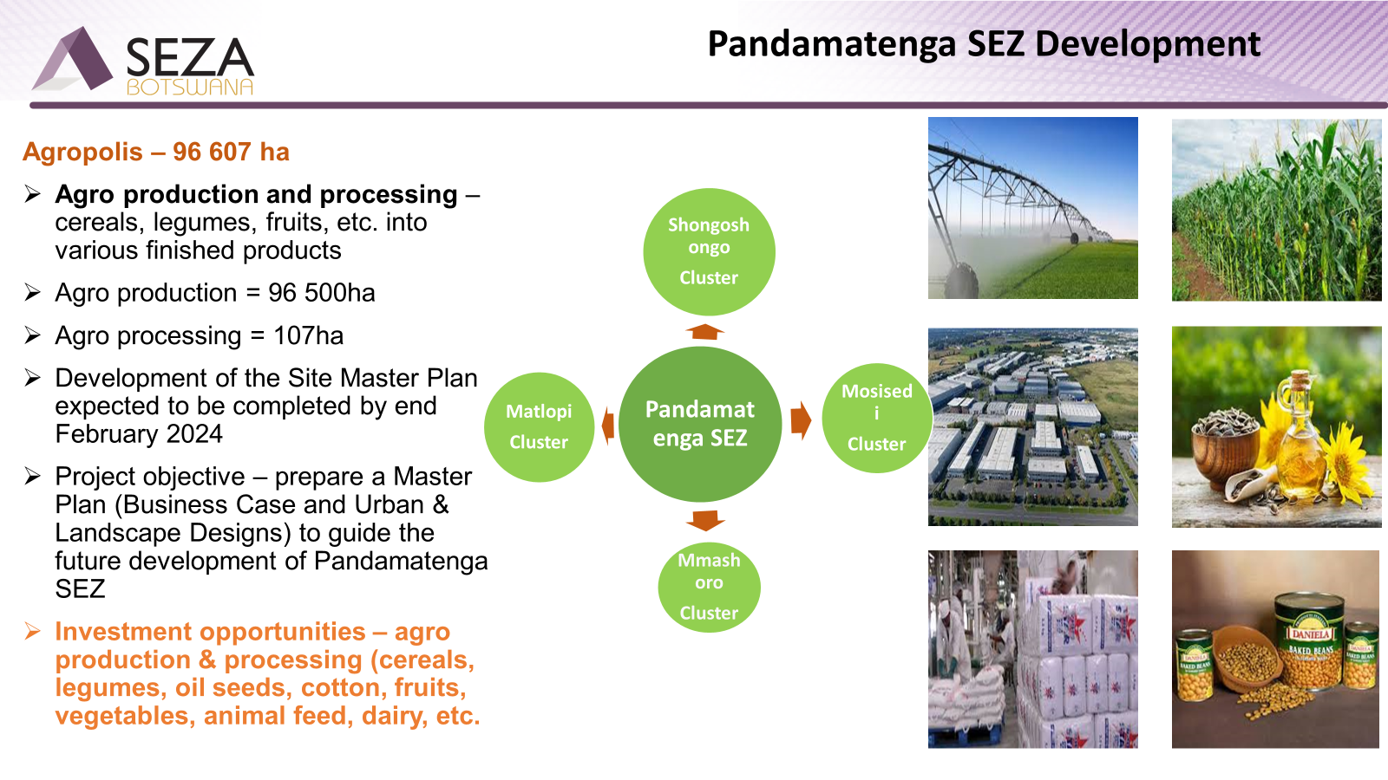
PROJECT IMPLEMENTATION PROGRESS

Slide 9


For more information please contact
Ms. Geraldine Sebusang–Investor Licensing Manager
email - sebusang@seza.co.bw

