Slide 1
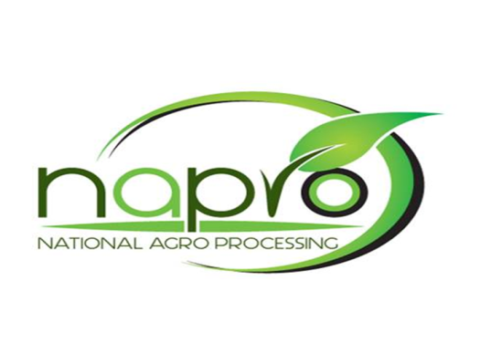

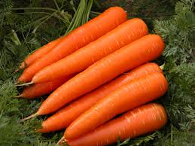

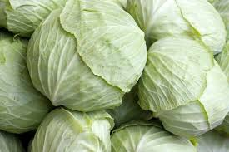

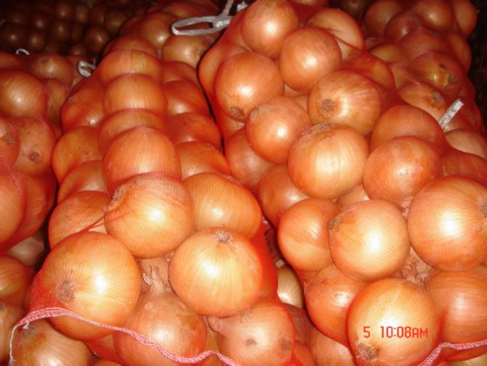

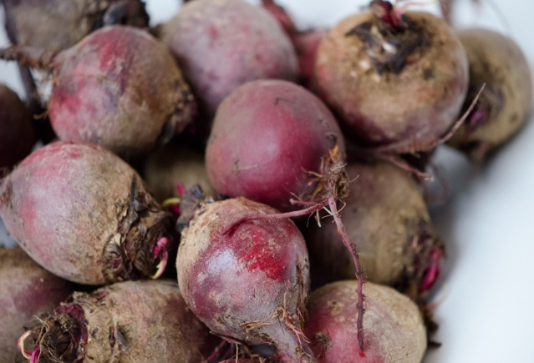
NAPro OVERVIEW
Metlha Lolo Mangwane

Slide 2
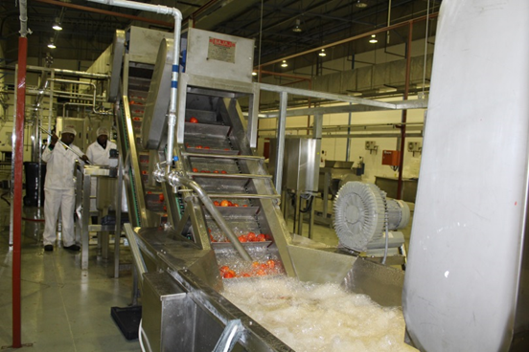
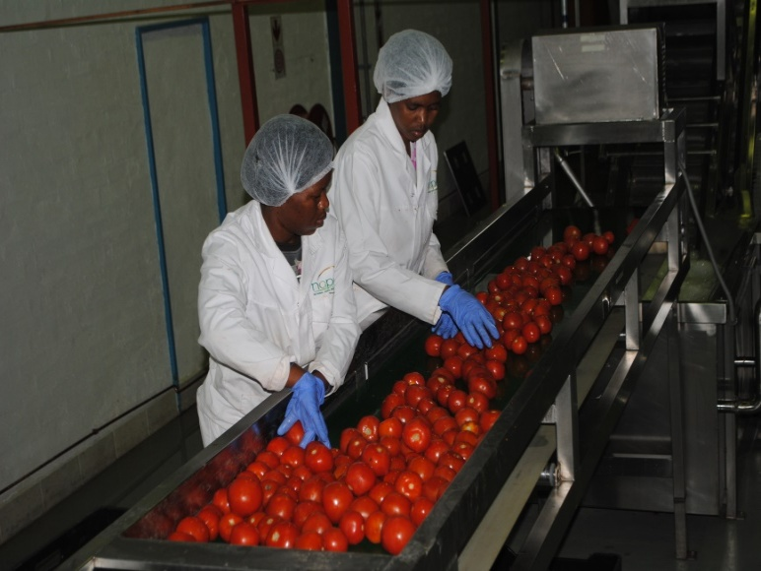
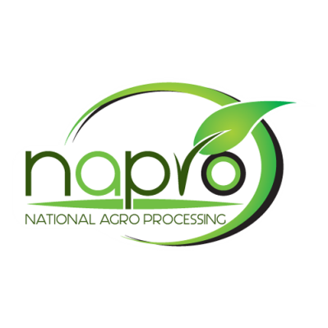
BRIEF ABOUT NAPRO
NATIONAL AGRO PROCESSING (PTY) LTD
An agro processing plant based in Selibe Phikwe with the focus on production of value added horticultural products of the most grown produce in Botswana i.e cabbage, tomatoes, onions, beetroots and carrots.
Established as a developmental project for expanding markets & stimulating growth of the horticultural sector, but operated as a sustainable commercial business.
100% subsidiary of NARDI

Slide 3
ROLE OF NAPRO AS AN OFFTAKER
Provides a guaranteed market for agricultural products
Reduce post harvest losses
Supports quality standards and grading
Reduces market uncertainty
Enables aggregation and scaling

Slide 4

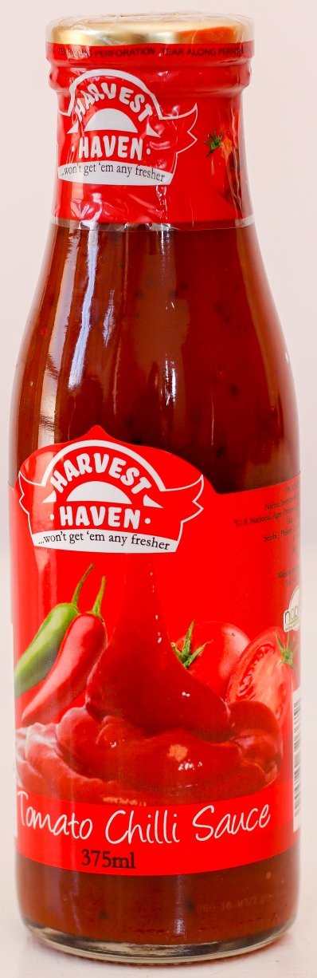
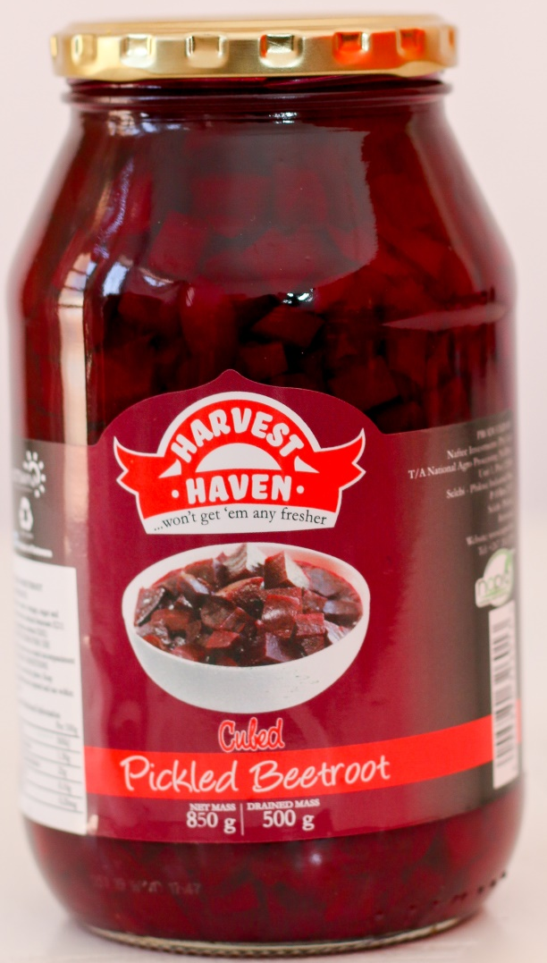
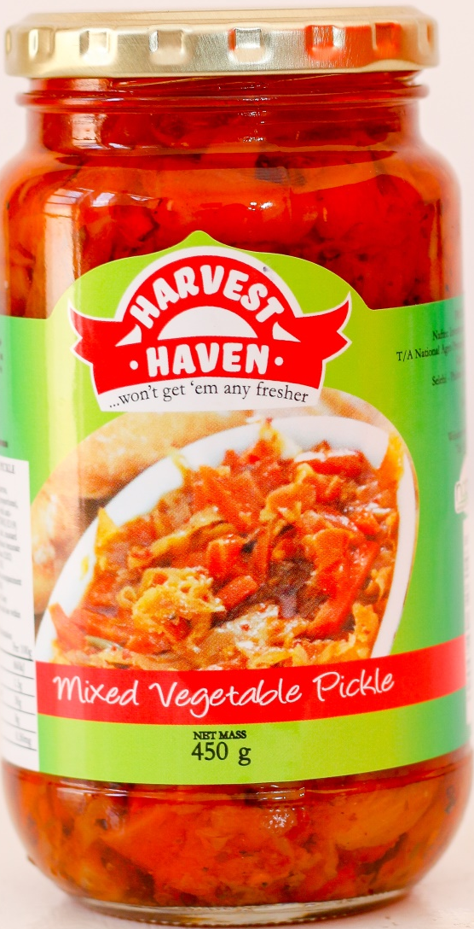
OUR PRODUCTS

Slide 5
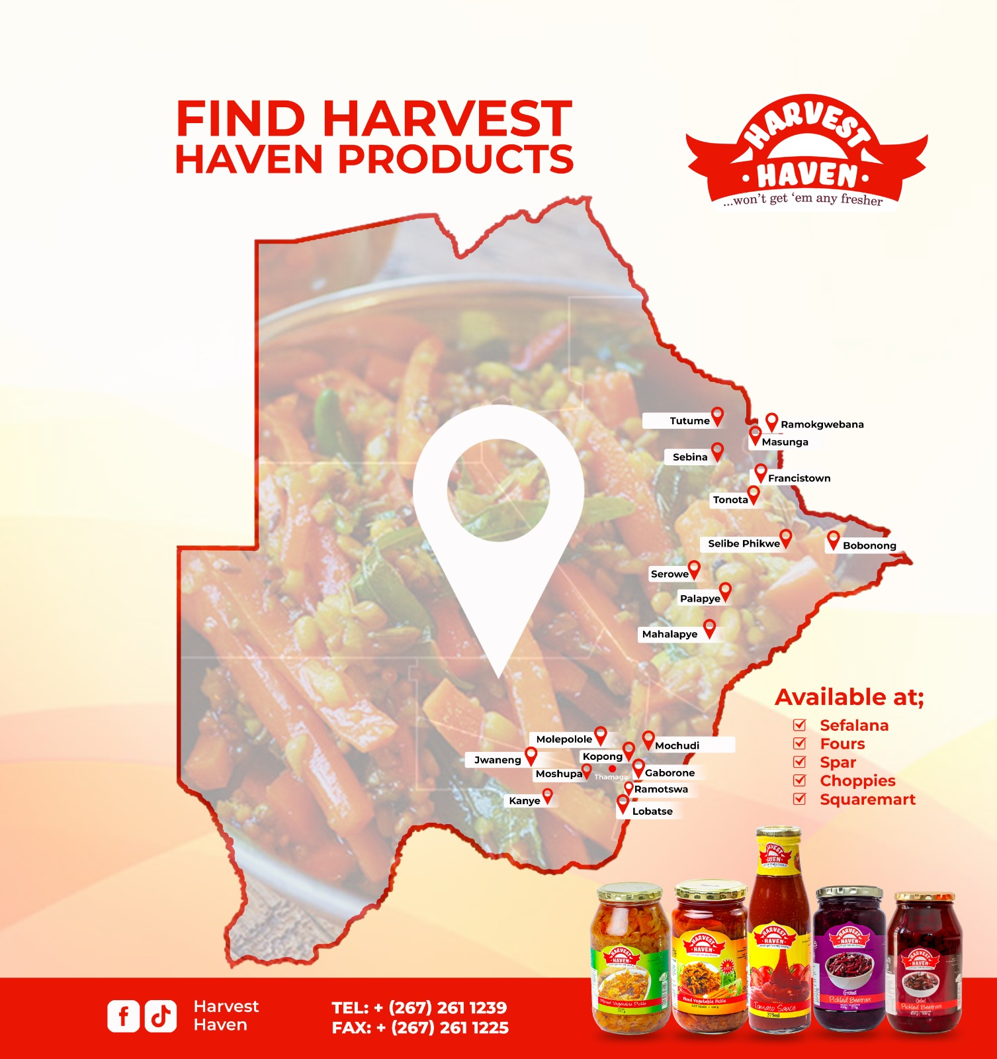
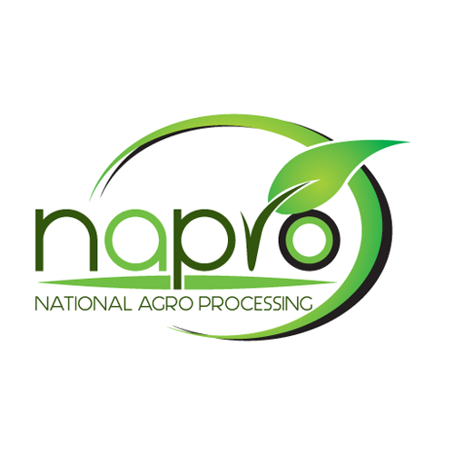
PRODUCT AVAILABILITY

Slide 6
PARTNERSHIP WITH FARMERS
Consistent supply of fresh raw materials
Support local agriculture and food security
Build long-term, sustainable relationships
Improve quality through collaboration

Slide 7
PROCUREMENT MODEL
Scheduled deliveries based on demand
Quality specifications provided upfront
Contract farming
Payment terms: 7-14 days after delivery

Slide 8
QUALITY REQUIREMENTS
Freshness and quality standards
Clean, disease-free produce
Proper handling and packaging
Compliance with food standards
Traceability where possible

Slide 9
CHALLENGES
MARKET | SUPPLY CHAIN
No buy in from Government Institutions due to unfavourable menu. | Quality variations
Strict trading terms | Inconsistent supply
Competition from imported brands | Seasonal production

Slide 10
PLANT INPUT REQUIREMENTS
Crop | Monthly Requirement (kg)
Tomato | 32 021
Beetroot | 40 042
Cabbage | 16 173
Carrot | 15 045
Onion | 36 468

Slide 11
PLANT UTILISATION LIMITATION
Limited production capacity
Manual equipment

Slide 12
CALL TO ACTION
Plant automation
Contract farming / anchor farms
Buy in of Harvest Haven products

Slide 13
Email: Sales@napro.co.bw
Tel: 2611239

