Slide 1

AGRO-PROCESSING & COMMODITY CLUSTERS WORKSHOP 2026
POTENTIAL FOR SAFFLOWER PRODUCTION AND VALUE ADDITION IN BOTSWANA ; The Case for Kweneng North Horticulture Farmers’ Co-op
By Godfrey Mudanga

Slide 2
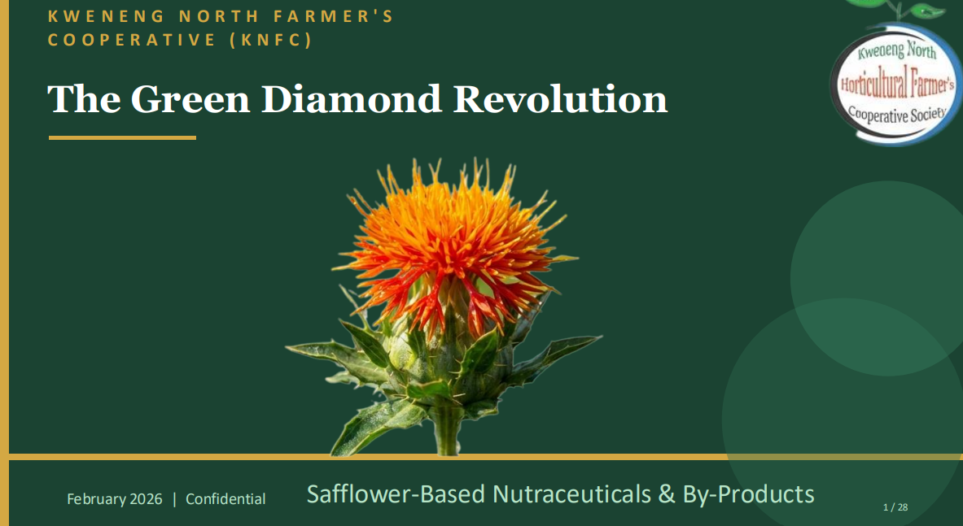

Slide 3
KNFC (GAIC)
COOPERATIVE PROFILE
Founded: November 2015, through an agreement between Botswana & Brazil to resuscitate Cooperatives. As a Horticulture Marketing Cooperative
Transformation: Re-registered in April 2026 under the name GRAND AGRO INDUSTRIES COOPERATIVE SOCIETY (GAIC) , as a multi-purpose cooperative.
Location: Kweneng North, but now has footprint across the whole country, e.g. Panda
Members: 70+ Farmers
Core Business: Horticulture and Safflower production, processing and marketing
Cooperative Business Model
Vertical integrated (from farming to marketing)
Farming
GAIC (or outsourced), GAIC members, Contracted farmers and Cooperatives
Agro-Processing SPVs
Oil & derivatives, Petal extracts, Fodder processing, Fertilizer processing
Savings and Credit SPV
Financial services for Cooperative members

Slide 4
WHY SAFFLOWER FOR BOTSWANA
BUAN Research
Researched since 2008 and findings well published BUAN google
A climate smart crop well adapted to arid semi-arid lands, tolerant to water deficit conditions (can be grown through rain fed)
Adapted to relatively high salinity water (high salinity common in Botswana) compared to maize, sunflower, soybean, peanuts
Can tolerate extremely low and high temperatures (therefore can be a rotation crop in winter) we are currently planting at Panda
KNHC (GAIC)
Members of KNHC have planted safflower since 2023
Areas include Kweneng, Jwaneng, Borolong, Kgatleng, Mahalapye, Palapye, Serowe Letlhakane, Tutume, Panda etc
Presentation made to Govt and Safflower included in the then Temo Letlotlo programme for 2024/2025
Members have pressed oil, produced cosmetics from the oil, packaged petals and crushed leaves and sold in the informal market. Samples at our stall

Slide 5
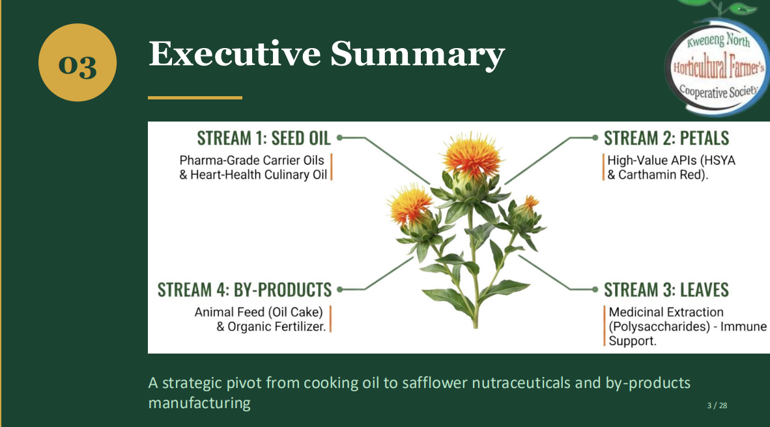
BENEFITS OF SAFFLOWER AT A GLANCE

Slide 6
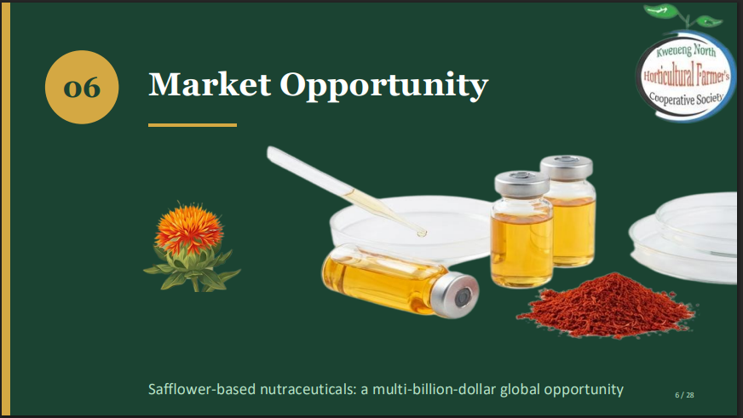

Slide 7
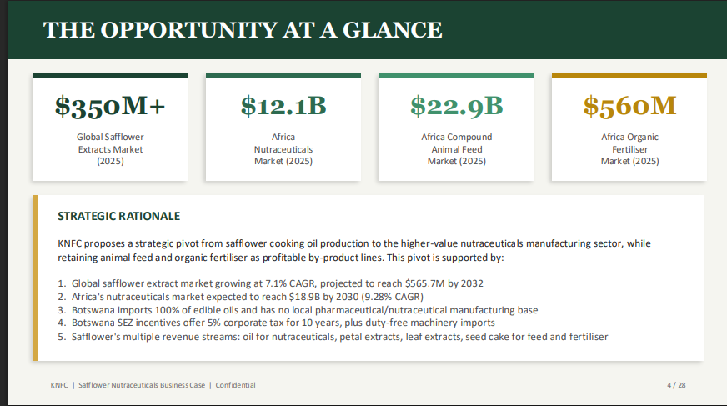

Slide 8
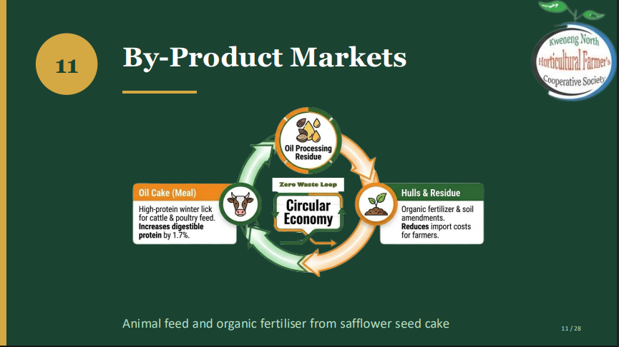

Slide 9
PHASED IMPLEMENTATION
PHASE 1
EDIBLE OIL
SUPPLEMENTS FROM PETALS & LEAVES (Basic packaging)
PHASE 2
LIVESTOCK FEED FROM SEED CAKE and STALKS
COSMETICS & OTHER INDUSTRIAL PRODUCTS FROM OIL AND PETALS
PHASE 3
NUTRACEUTICALS/PHARMACEUTICALS
ORGANIC FERTILIZER

Slide 10
